Slide 1
How to Start a Data Quality Management (DQM) Program – Technology
Dr. David Marco
IIM Fellow, CDP, CBIP, IIBA Analytics Expert
President

Slide 2




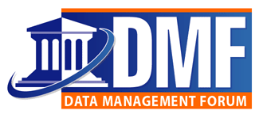






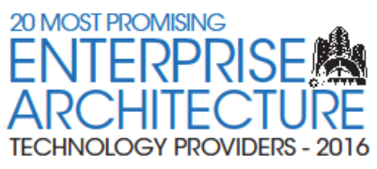
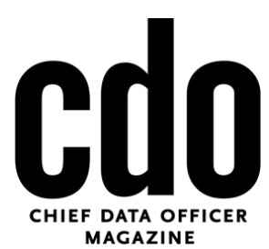
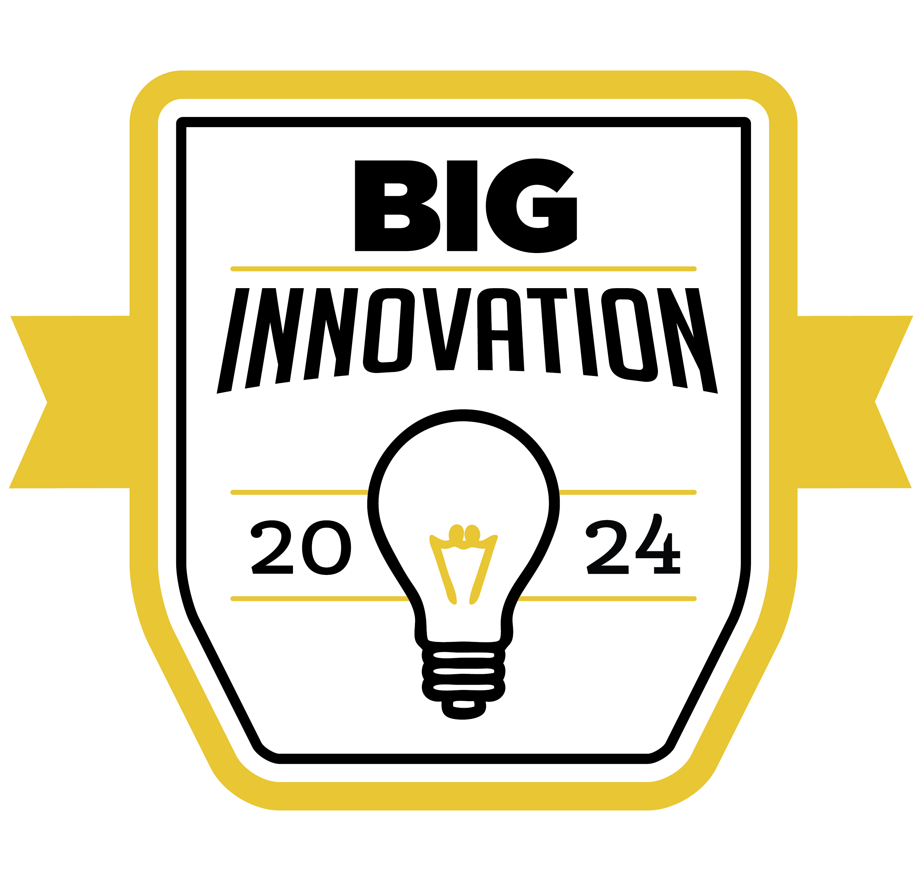


EWSolutions’ Background
EWSolutions is a Chicago-headquartered strategic partner and full life-cycle systems integrator providing our client partners a full range of services for any size enterprise data governance, data literacy, data management, and data warehouse/advanced analytics initiative. Our notable client partner projects have been featured in the Chicago Tribune, CDO Magazine, Federal Computer Weekly, Journal of the American Medical Informatics Association (JAMIA), Crain’s Chicago Business, FBI, and The Doings. We have won the Intelligent Enterprise’s RealWare award, the Excellence in Information Integrity Award nomination, DM Review’s World Class Solutions award, the 2016 CIO Review 20 Most Promising Enterprise Architecture providers award, the 2018 Innovation & Excellence award, the 2024 BIG Innovation Award, and are a 19-time winner of the Chicago Awards, with induction into their Hall of Fame.
Excellence and Thought Leadership
Best Business Intelligence Application
Information Integration
Client: Department of Defense
LinkedIn Top Voice, 2024 Data Governance, 2023 Business Intelligence
FBI
Meritorious Service Award
Excellence in Information Integrity Award Nomination
Email us at info@EWSolutions.com to learn more about our services and training

Slide 3

Over 155 Client Partners Since 1997
AFLAC
AgVantis
AON (Hewitt Associates)
Arizona Supreme Court
Bank of America (Countrywide)
Bank of Montreal
BankUnited
Basic American Foods
Becton, Dickinson and Company
Blue Cross Blue Shield Association
Blue Cross Blue Shield companies
Booz Allen Hamilton
Branch Banking & Trust (BB&T)
Bristol-Myers Squibb
British Petroleum (BP)
California DMV
California State Fund
Canadian Institute for Health Information (CIHI)
Canadian National Railway
Capella University
Centers for Medicare & Medicaid Services (CMS)
Cigna
College Board
Comcast
Corning Cable Systems
Contech Systems, Inc.
CostCo
D.A. Davidson
Defense Logistics Agency (DLA)
Delta Dental
Department of Defense (DoD)
Department of Homeland Security (DHS)
Department of the Interior
Discover
Driehaus Capital Management
Eli Lilly and Company
Environment Protection Agency (EPA)
Erwin
Fannie Mae
Farmers Insurance Group
Federal Aviation Administration
Federal Bureau of Investigation (FBI)
FedEx
FEMA
Fidelity Information Services
FICO (Fair Issac)
Ford Motor Company
GlaxoSmithKline
Harbor Funds
Harris Bank (BMO)
The Hartford
Harvard Pilgrim HealthCare
Health Care Services Corporation
Henny Penny
HP (Hewlett-Packard)
IDMA (Insurance Data Mgt. Institute)
Information Resources Inc.
International Paper
IQVIA (Quintiles)
Janus Mutual Funds
Johnson Controls
Key Bank
LiquidNet
Loyola Medical Center
Manulife Financial (John Hancock Fin.)
Mayo Clinic
McDonalds
Micron
Microsoft
MoneyGram
NASA
National City Bank (PNC Financial)
Nationwide
Neighborhood Health Plan
NORC
Physicians Mutual Insurance
Pillsbury
Quartz Benefits
Rowan College of South Jersey (RCSJ)
Sallie Mae
Saudi Arabia Minister of the Interior
Saudi Telecom Company (STC)
Schneider National
Secretary of Defense/Logistics
Singapore Defense Science & Technology Agency (DSTA)
Social Security Administration
South Orange County Community College
Spherion
Standard Bank of South Africa
SunBelt Rentals
SunTrust Bank
Surescripts
Swagelok
Target Corporation
Texas CPA
The Regence Group
Thomson Multimedia (RCA)
Thrivent Financial
United Healthcare (UHC)
United Health Group
United Nations (ICAO)
United States Air Force
United States Federal Courts
United States Department of State
United States Fish and Wildlife Service
United States Navy
United States Navy (BUPERS)
United States Transportation Command
University of Michigan
University of Wisconsin Health
USAA
US Cellular
Vera Bradley
Waste Management
Wells Fargo
Wisconsin Department of Transportation
Workers’ Compensation Insurance Rating Bureau of California (WCIRB)
Zurich Cantonal Bank

Slide 4



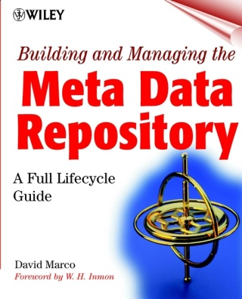


Dr. David Marco – Professional Profile
Best known as the world’s foremost authority on metadata management and the father of the Managed Metadata Environment, he is an internationally recognized expert in the fields of data governance, digital transformation, data literacy, big data, data warehousing, master data management, and data management. In 2004, Dr. David Marco was named the “Melvil Dewey of Metadata” by Crain’s Chicago Business as he was selected to their very prestigious “Top 40 Under 40” list. Dr. Marco has authored several books, including the widely acclaimed “Universal Metadata Models” (Wiley, 2004) and the classic “Building and Managing the Metadata Repository: A Full Life-Cycle Guide” (Wiley, 2000).
2024 LinkedIn Top Data Governance Voice
2024 BIG Innovation Award Winner – Data Management and CDO
2023 LinkedIn Top Business Intelligence (BI) Voice
2022 & 2024 IDMMA Data Management Professional of the Year
2022 CDO Magazine Top Data Consultants in North America
2021 he was named an IIBA Analytics Expert
2020 received a lifetime professional Fellowship from the Institute of Information Management (their highest honor)
Author of several best-selling information technology books, including the top 2 sellers in metadata management history
2016 Data Management Channel Expert for Business Analytics Collaborative
2008 DAMA Data Management Hall of Fame (Professional Achievement Award)
2007 DePaul University named him one of their “Top 14 Alumni Under 40”
Selected for the prestigious 2004 Crain’s Chicago Business “Top 40 Under 40”
Worked with over 60 client partners to successfully build their data management & and governance programs
Presented hundreds of keynotes/seminars across four continents
Published hundreds of IT articles, some of which were translated into Mandarin, Russian, Italian, Portuguese, and others
Taught at the University of Chicago and DePaul University
Holds Ph.D. (Hon), MBA, IIM Fellow, CDP, CCP, and CBIP certifications
Email: DMarco@EWSolutions.com

Slide 5

How to Start a Data Quality Program
Data quality management programs are a combination of People, Process, and Technology
People – August 6, 2025, 11 am CT
  Create a Data Quality Team Integrated into the Data Governance Team
  Establish Data Quality Metrics and KPIs
  Identify Key Data Quality Stakeholders
  Define Clear Data Ownership
Process – September 4, 2025, 11 am CT
  Define Business Terms with Valid Values
  Implement a Data Quality Remediation Framework
  Implement Data Quality Rules
  Define Data Quality Defect Categories
Technology – October 8, 2025, 11 CT
  Implement a Data Quality Tool
  Ensure your Data Quality Tool has full Data Governance and Metadata Management Functionality
  Data Quality Tool Must Have Artificial Intelligence and Machine Learning (AI/ML) Capabilities
  Publish Data Quality Dashboards (strategic) and Detailed Defect Reports (tactical)

Slide 6

Agenda
How to Start a Data Quality Program – Technology
  Implement a Data Quality Tool
  Ensure your Data Quality Tool has full Data Governance and Metadata Management Functionality
  Data Quality Tool Must Have Artificial Intelligence and Machine Learning (AI/ML) Capabilities
  Publish Data Quality Dashboards (strategic) and Detailed Defect Reports (tactical)
Data Quality Measure and Monitoring
Data Quality Reporting & Examples

Slide 7
Implement a Data Quality Tool

Slide 8

Implement a Data Quality Tool
If your organization is a large federal agency or a $500M+ corporation, you’ll need a DQ tool
These tools accomplish much, including the following DQ functions:
  Data quality rules creation, management, and execution
  Defect identification and classification
  Data profiling
  Defect error logging from data stewards and system users
  DQ workflow
  DQ monitoring
  DQ executive dashboards
  DQ defect reporting
  Data duplicate identification
  PII & PHI identification, masking, and encryption
  Data enrichment (missing data)
  Tracking data access
  Zip code checking, etc.
Learning Point: When evaluating a DQ tool with metadata management and data governance functions, our checklist grades each tool on around 120 different capabilities

Slide 9






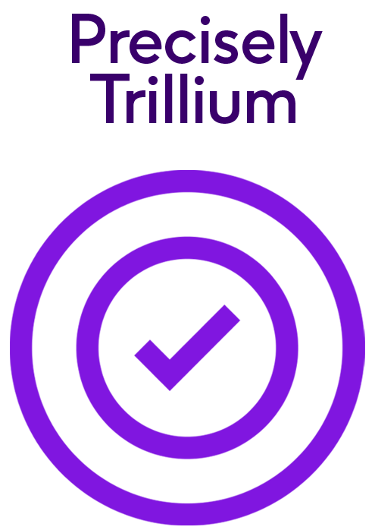
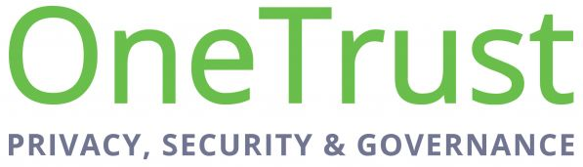





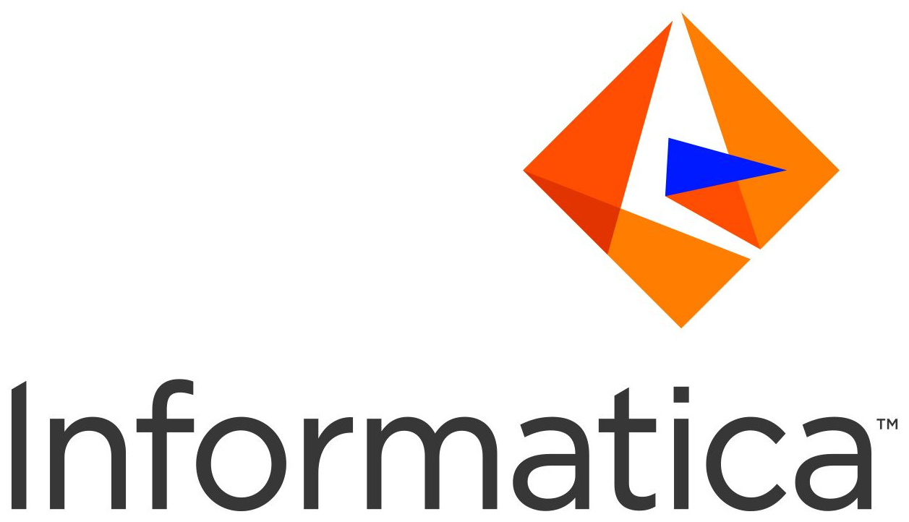



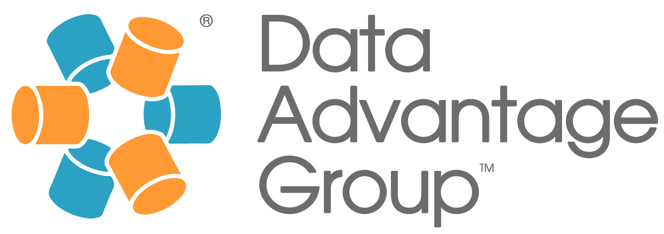







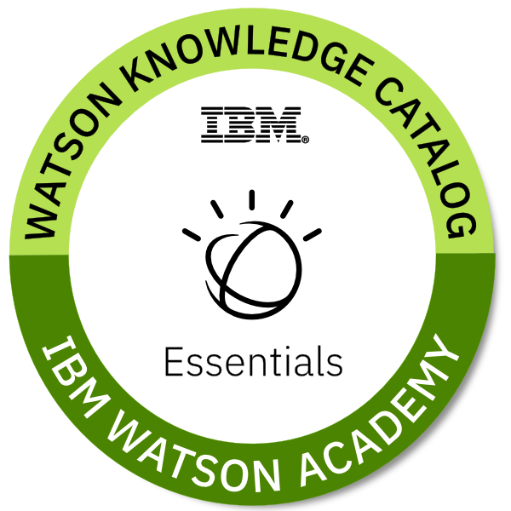










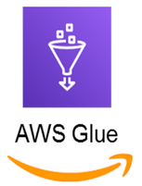






Sample Data Catalog, Repository, & DQ Vendors

Slide 10
Ensure your Data Quality Tool has full Data Governance and Metadata Management Functionality

Slide 11
Ensure your Data Quality Tool has full Functionality
It’s expensive and complex to integrate data quality tools with data governance solutions
Many DQ tools allow for direct write-back to the application. This is a dangerous approach unless you have experience doing it successfully
  Most organizations will not allow write-back
Learning Point: Ensure that your data quality tool has full metadata management and data governance functionality

Slide 12

Data Quality Tool Must Have AI/ML Capabilities

Slide 13
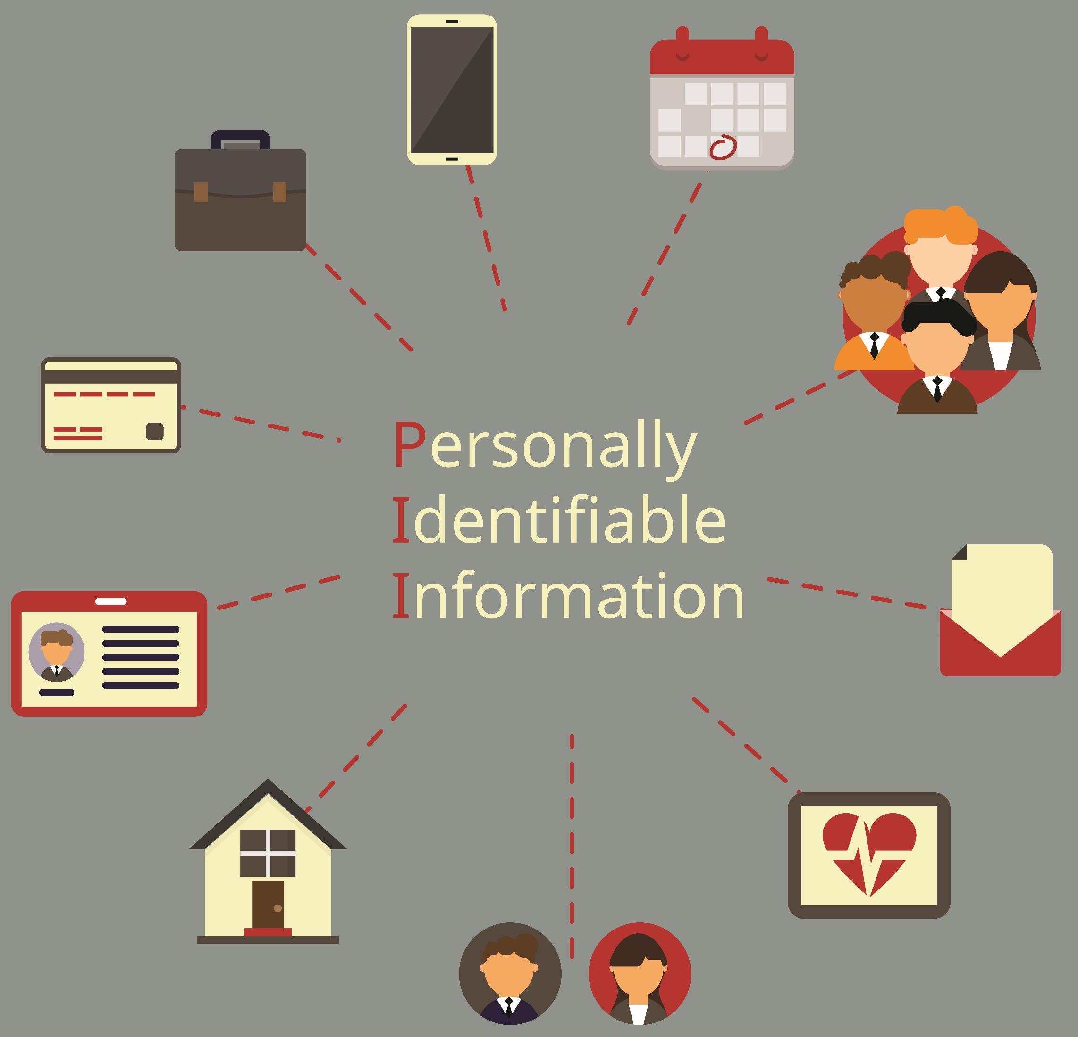
Data Quality Tool Must Have AI/ML Capabilities
AI/ML is revolutionizing data quality tool development
AI/ML takes common tasks and can partially automate them for tens of thousands of hours of time savings
Common AI/ML capabilities for DQ include:
  DQ Rules Generation
  Automatic PII Identification
  Authoritative Data Element Analysis
Learning Point: AI/ML will provide even more value to DQM initiatives as it matures

Slide 14
Publish Data Quality Dashboards and Detailed Defect Reports

Slide 15
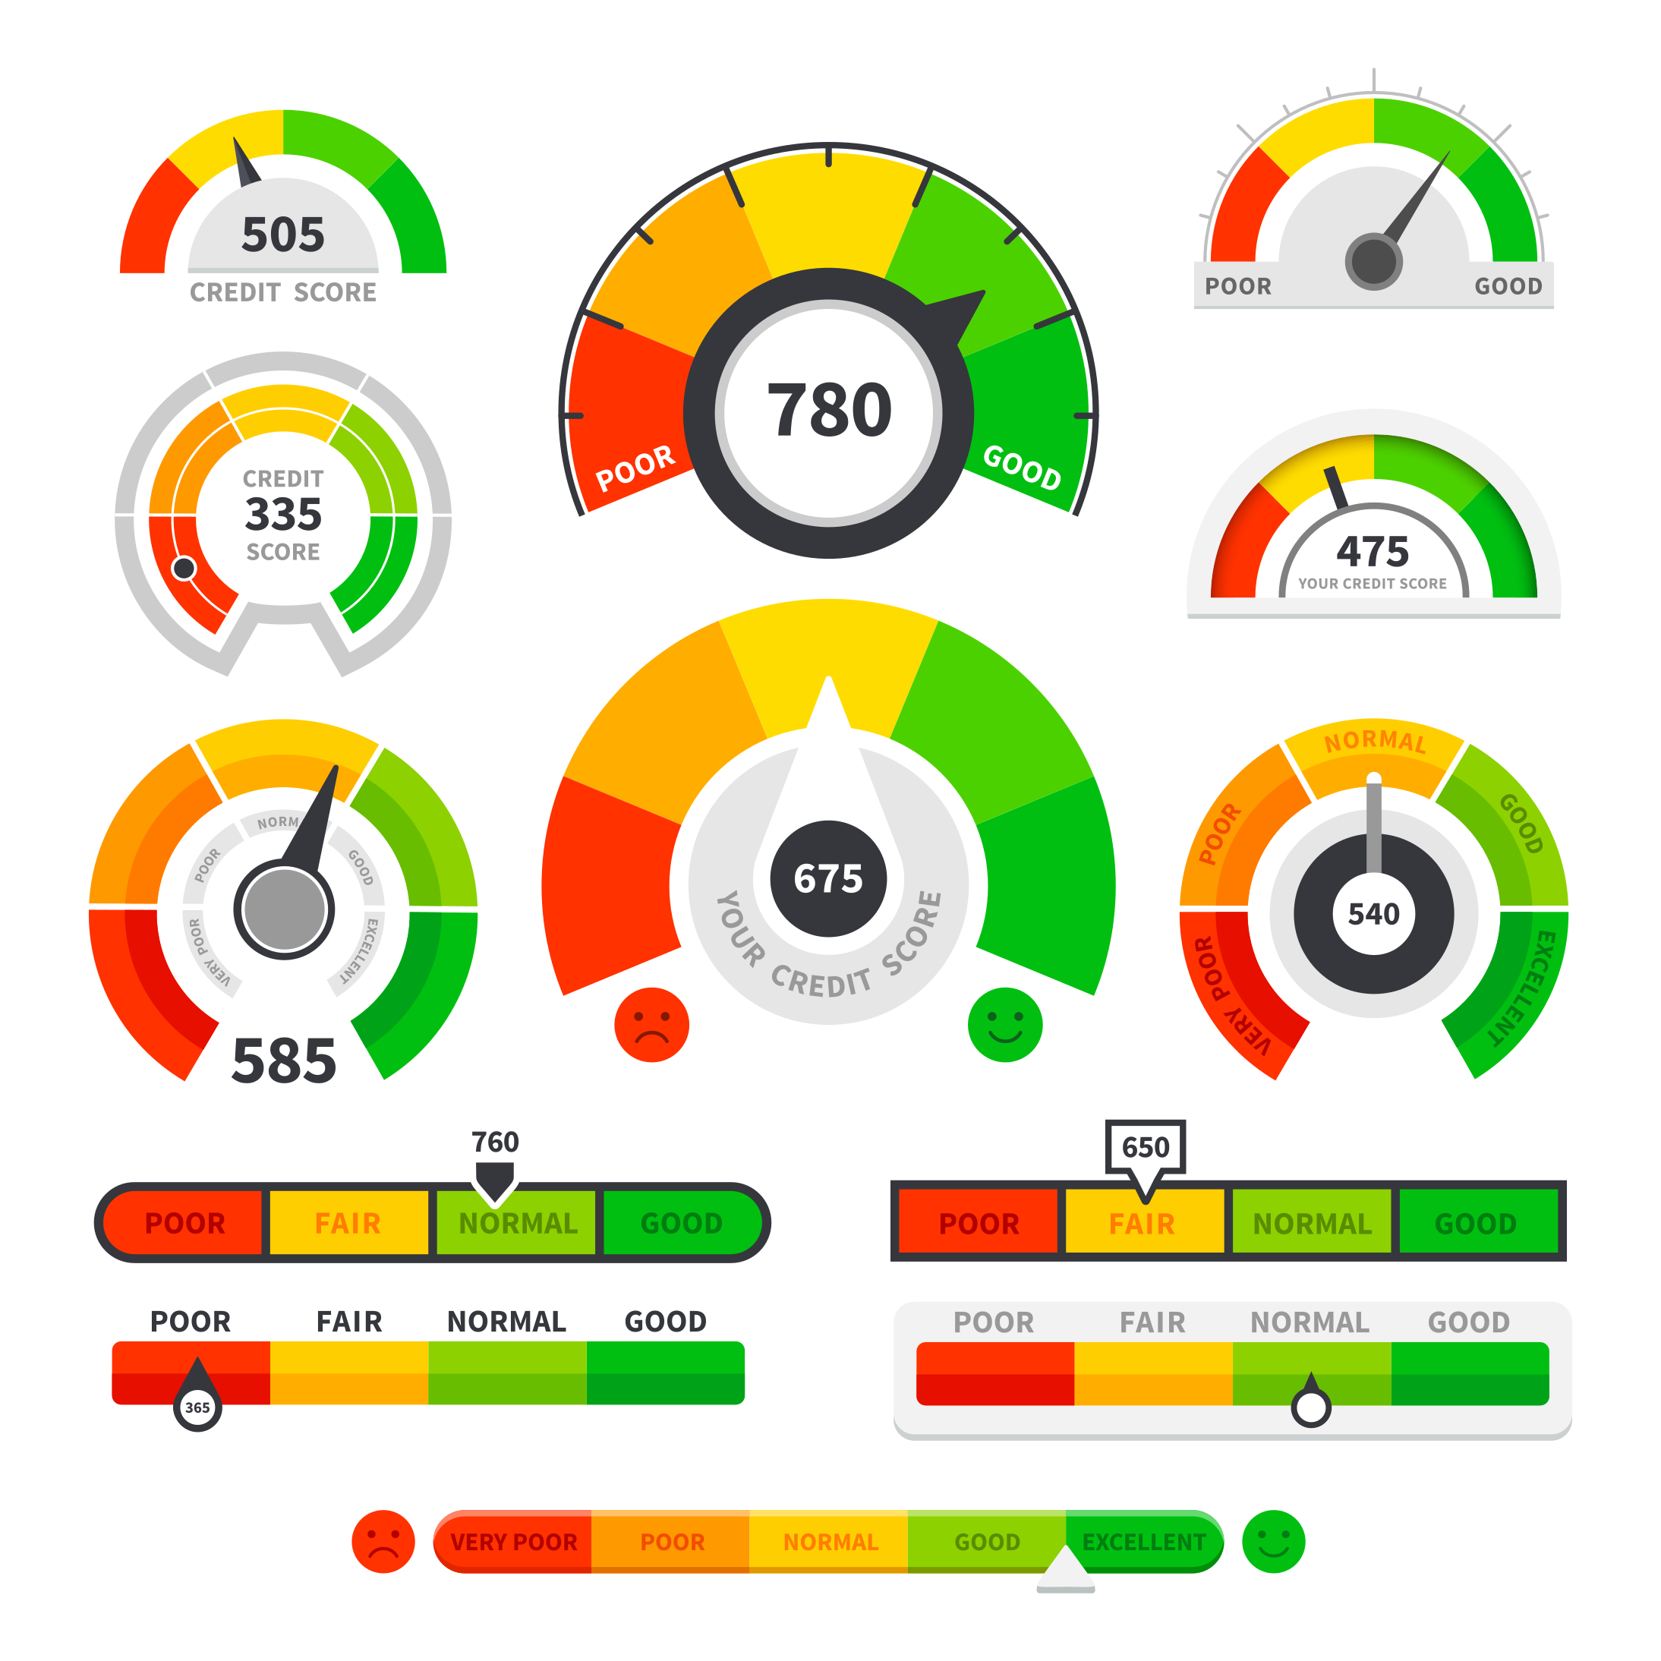
Publish Data Quality Dashboards and Detailed Defect Reports
When DQ rules are executed from a DQ tool, dashboards and defect reports can be automatically generated
DQ Dashboards (strategic) are of interest to executives that want to understand how the DQ program is succeeding
DQ Defect Reports are tactical and help application owners identify the data that is defective
Learning Point: This is some of the most important functionality of a DQ tool

Slide 16
Data Quality Measure and Monitor Processes

Slide 17
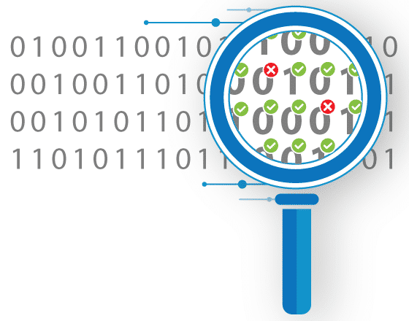
Data Quality Process
Data Quality Measure: Measuring the data’s quality is vital to the DQM program. Use the 10 Data Quality Dimensions as the foundation for the metrics and KPIs that your program defines and uses
Data Quality Monitoring: The continued monitoring of Data Quality, based on the results of executing the Data Quality rules, and the comparison of those results to defined error thresholds, the creation and storage of Data Quality exceptions, and the generation of appropriate notifications
Learning Point: Typically, these technical processes CANNOT be run during high-peak hours

Slide 18
Measure and Monitor Data Quality
Two approaches for DQ control and measurement: in-stream and batch
  In-stream: Edit checks in applications, data element validation services, specially programmed processes (data movement)
    These need to be built within the applications
  Batch: Direct queries, using a data profiling or data quality tools
Measurements are applied at three levels of granularity:
  Data element value: Completeness, structural consistency, reasonableness, accuracy, etc.
  Data instance or record: Completeness, structural consistency, semantic consistency, reasonableness, accuracy, etc.
  Data set: Aggregate measures, such as record counts, sums, mean, variance – usually batch
Notes:
Continuously Measure and Monitor Data Quality
For conformance to data quality business rules, two contexts for control and measurement exist: in-stream and batch. In turn, apply measurements at three levels of granularity, namely data element value, data instance or record, and data set, making six possible measures. Collect in-stream measurements while creating the data, and perform batch activities on collections of data instances assembled in a data set, probably in persistent storage.
Provide continuous monitoring by incorporating control and measurement processes into the information processing flow. It is unlikely that data set measurements can be performed in-stream, since the measurement may need the entire set. The only in-stream points are when full data sets hand off between processing stages. Incorporate data quality rules using the techniques detailed in in this table. Incorporating the results of the control and measurement processes into both the operational procedures and reporting frameworks enable continuous monitoring of the levels of data quality.

Slide 19

Measure and Monitor Data Quality
Collect in-stream measurements while creating the data. Normally this is not technically feasible
Perform batch activities on collections of data instances assembled in a data set, probably in persistent storage
Incorporating the results of the measurement and monitoring processes into both the operational procedures and reporting frameworks to enable continuous monitoring of the levels of data quality
Notes:
Continuously Measure and Monitor Data Quality
For conformance to data quality business rules, two contexts for control and measurement exist: in-stream and batch. In turn, apply measurements at three levels of granularity, namely data element value, data instance or record, and data set, making six possible measures. Collect in-stream measurements while creating the data, and perform batch activities on collections of data instances assembled in a data set, probably in persistent storage.
Provide continuous monitoring by incorporating control and measurement processes into the information processing flow. It is unlikely that data set measurements can be performed in-stream, since the measurement may need the entire set. The only in-stream points are when full data sets hand off between processing stages. Incorporate data quality rules using the techniques detailed in in this table. Incorporating the results of the control and measurement processes into both the operational procedures and reporting frameworks enable continuous monitoring of the levels of data quality.

Slide 20
Data Quality Reporting

Slide 21
Data Quality Incident Tracking
Data quality incident tracking requires a focus on training staff to recognize when data issues appear and how they are to be classified, logged, and tracked according to the data quality service level agreements (SLA)
  Standardize data quality issues and activities
  Provide an assignment process for data issues
  Manage issue escalation procedures
  Manage data quality resolution workflow
Notes:
Data quality incident tracking also requires a focus on training staff to recognize when data issues appear and how they are to be classified, logged, and tracked according to the data quality SLA. The steps involve some or all of these directives:
Standardize data quality issues and activities: Since the terms used to describe data issues may vary across lines of business, it is valuable to standardize the concepts used, which can simplify classification and reporting. Standardization will also make it easier to measure the volume of issues and activities, identify patterns and interdependencies between systems and participants, and report on the overall impact of data quality activities. The classification of an issue may change as the investigation deepens and root causes are exposed.
Provide an assignment process for data issues: The operational procedures direct the analysts to assign data quality incidents to individuals for diagnosis and to provide alternatives for resolution. The assignment process should be driven within the incident tracking system, by suggesting those individuals with specific areas of expertise.
Manage issue escalation procedures: Data quality issue handling requires a well-defined system of escalation based on the impact, duration, or urgency of an issue. Specify the sequence of escalation within the data quality SLA. The incident tracking system will implement the escalation procedures, which helps expedite efficient handling and resolution of data issues.
Manage data quality resolution workflow: The data quality SLA specifies objectives for monitoring, control, and resolution, all of which define a collection of operational workflows. The incident tracking system can support workflow management to track progress with issues diagnosis and resolution.

Slide 22

Data Quality Reporting
Data Quality Reporting: Creating, delivering and refining reports, dashboards and scorecards used to identify trends against stated Data Quality measures and to examine detailed Data Quality exceptions

Slide 23

Data Quality Reporting
All the activities of DQM must be supported by reporting of the results of these activities
Many organizations develop / adopt a user interface to report results for data quality measurement, metrics and activity
Use results to communicate value of data quality management program to meeting business goals and performance objectives
Notes:
Data Quality Reporting
Inspection and monitoring of conformance to data quality expectations, monitoring performance of data stewards conforming to data quality SLAs, workflow processing for data quality incidents, and manual oversight of data cleansing and correction are all supported by good reporting. It is optimal to have a user interface to report results associated with data quality measurement, metrics, and activity. It is wise to incorporate visualization and reporting for standard reports, scorecards, dashboards, and for provision of ad hoc queries as part of the functional requirements for any acquired data quality tools.

Slide 24
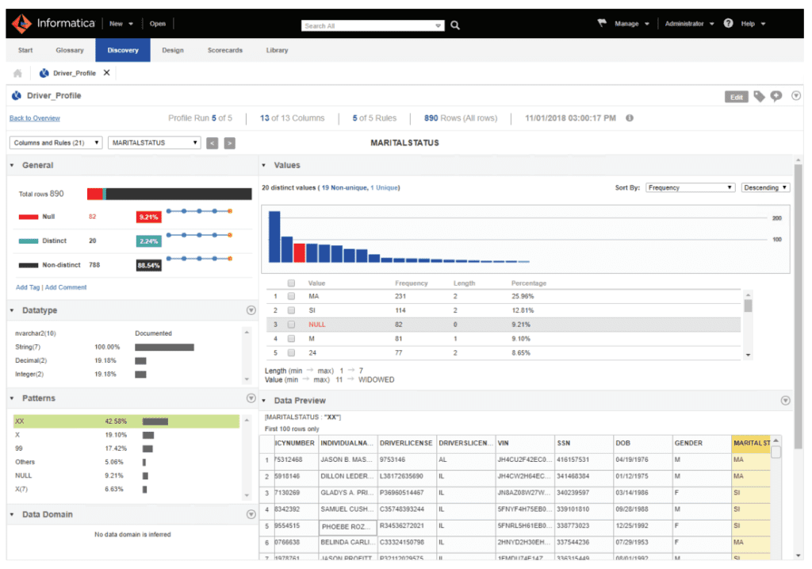
Data Quality Dashboard Example – Informatica

Slide 25
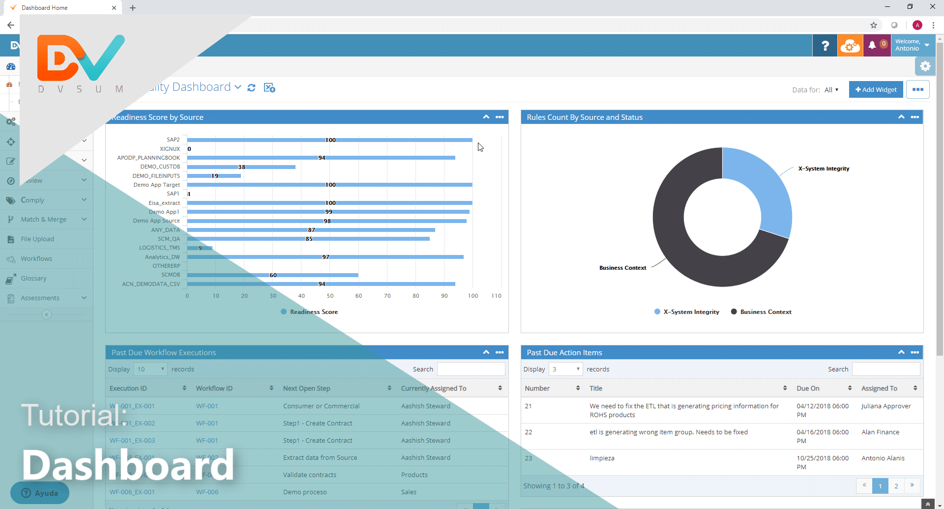
Data Quality Dashboard Example – DV Sum

Slide 26
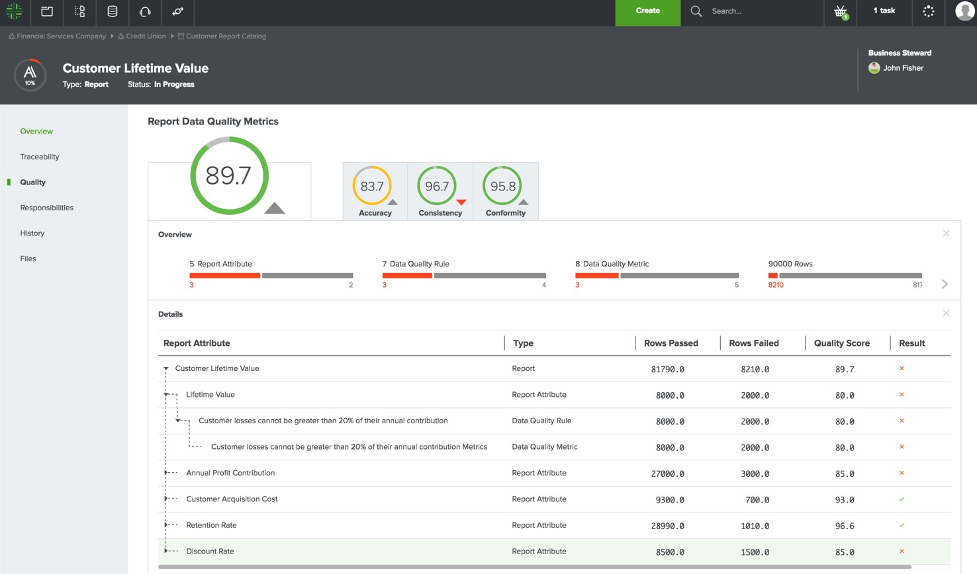
Data Quality Dashboard Example – Collibra

Slide 27
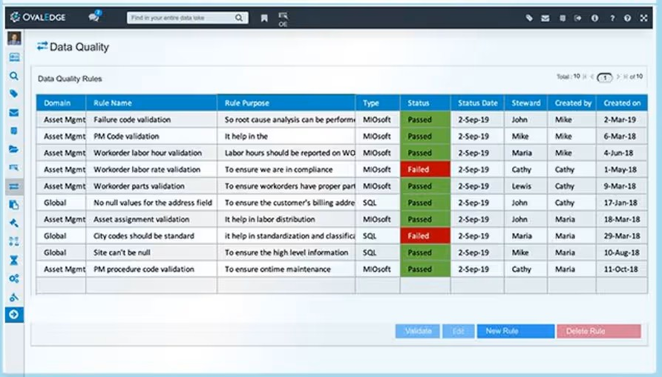
Data Quality Dashboard Example – Ovaledge

Slide 28

In the Final Analysis

Slide 29

Learning Points
If you don’t have data quality software, you can’t implement an enterprise DQM program
A good DQ tool can provide metadata management and data governance capabilities as well
Measure twice, buy once

Slide 30

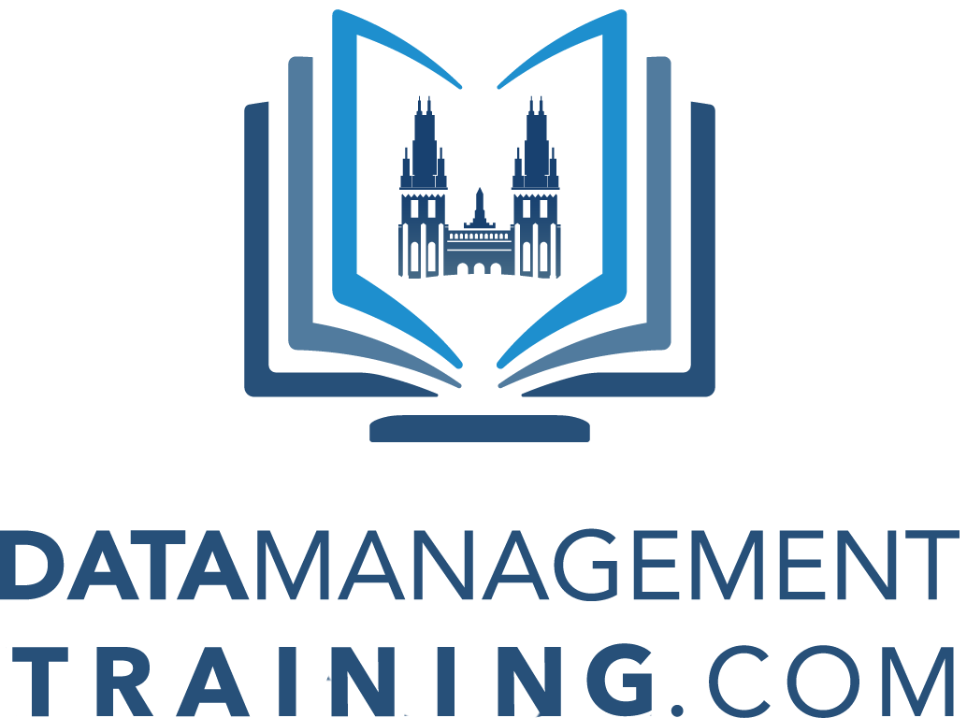

Questions & Answers
Data Management Consulting Services
Over 150 Client Partners
100% Data Management Success since 1997
World-Class Training
More than 40 courses, taught by industry experts. Over 160 satisfied client partners
Online, On-Demand Courses
Free Knowledge Portal

