Slide 1
Data Governance ROI: The Cost of Decisions That Don’t Hold
David Marco, PhD
DMarco@EWSolutions
President & Executive Advisor, EWSolutions

Slide 2
Context for Today’s Executive Briefing
David Marco, PhD President & Executive Advisor, EWSolutions
Over 25 years advising senior leaders on data governance, analytics, and decision accountability at enterprise scale
Trusted by large healthcare, financial services, manufacturing, and federal organizations to design governance that holds under audit, regulation, and operational pressure
Work on metadata-driven governance and enterprise decision support cited in JAMIA and adopted as a foundational capability across dozens of large institutions
Former lead architect and project manager for mission-critical counterterrorism analytics and governance at the FBI
Selected organizations advised (representative, not exhaustive)
Mayo Clinic • Blue Cross Blue Shield • BP • DoD • Discover • UnitedHealth • DHS
This briefing reflects patterns observed across multiple industries and regulatory environments, not a single organization’s experience

Slide 3
The Executive Blind Spot
Most organizations struggle to articulate the ROI of data governance
Not because the value isn’t real, but because they are measuring the wrong thing
This briefing will not explain why data governance matters. It will show where its economic returns actually show up

Slide 4
The Reframe
Data governance ROI rarely shows up as a savings line item
It shows up as fewer executive decisions being revisited, escalated, or reversed

Slide 5
Why This Matters to Executives
Executives don’t fund data governance for compliance alone
They fund it to:
protect decision credibility
reduce downstream exposure
ensure confidence under scrutiny
Governance exists to make leadership decisions defensible even when challenged

Slide 6
Data Governance Myths

Slide 7
Myth #1: ROI Comes from Compliance
Compliance avoids penalties
It does not create speed
Organizations that govern only for compliance:
move cautiously
escalate frequently
intervene late
still revisit decisions
Governance built for regulators will still fail executives

Slide 8
Myth #2: ROI Comes from Data Quality Improvements
Improving data quality is necessary
It is not sufficient
Quality without decision authority still produces rework
When authority is unclear:
validation repeats
definitions drift
analytics restart
trust erodes

Slide 9
Myth #3: ROI Comes from Consolidation
Consolidation feels efficient
But consolidation without integration:
centralizes confusion
multiplies risk
accelerates exposure
Centralization without authority just concentrates the problem

Slide 10
Summarizing the Myths
All three myths fail for the same reason. They optimize artifacts instead of executive decisions

Slide 11
Data Governance Reality

Slide 12
The Real Economic Drain Executives Don’t See
Most organizations don’t suffer from a lack of data
They suffer from a lack of decision clarity
The real costs show up as:
repeated validation cycles
duplicated analytics
shadow data pipelines
stalled initiatives
late executive intervention
Every time a decision has to be re-argued, ROI evaporates

Slide 13
Hidden Exposure: Uncontrolled PII
In one organization, governance tooling revealed:
Over 700% redundancy of sensitive PII
stored across individual machines and unmanaged environments
The cost wasn’t storage
The cost was exposure leadership didn’t know existed
This is what negative data governance ROI looks like in practice

Slide 14
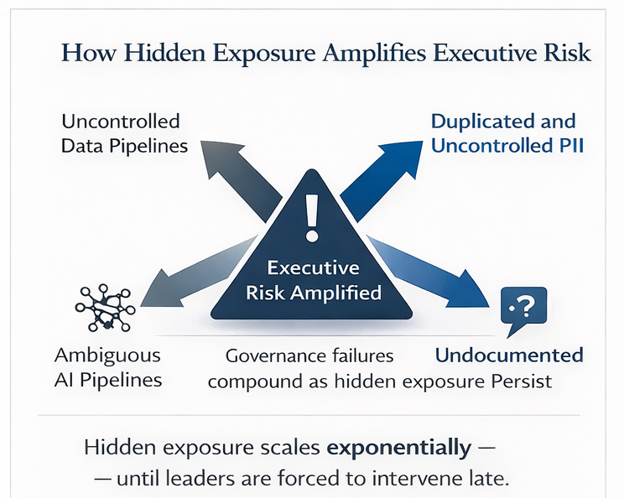
How Hidden Exposure Amplifies Executive Risk

Slide 15
Regulations
Regulation does not create the business case for governance
It reveals whether one already exists
Organizations with proper governance absorb regulatory pressure once
Organizations without it pay repeatedly

Slide 16
AI Changes the ROI Equation
AI accelerates decisions
It also accelerates mistakes
Poor data governance in an AI environment:
multiplies exposure
forces intervention
erodes trust faster than humans ever could
Right now, this burden often sits with CIOs
That model will not hold at scale

Slide 17
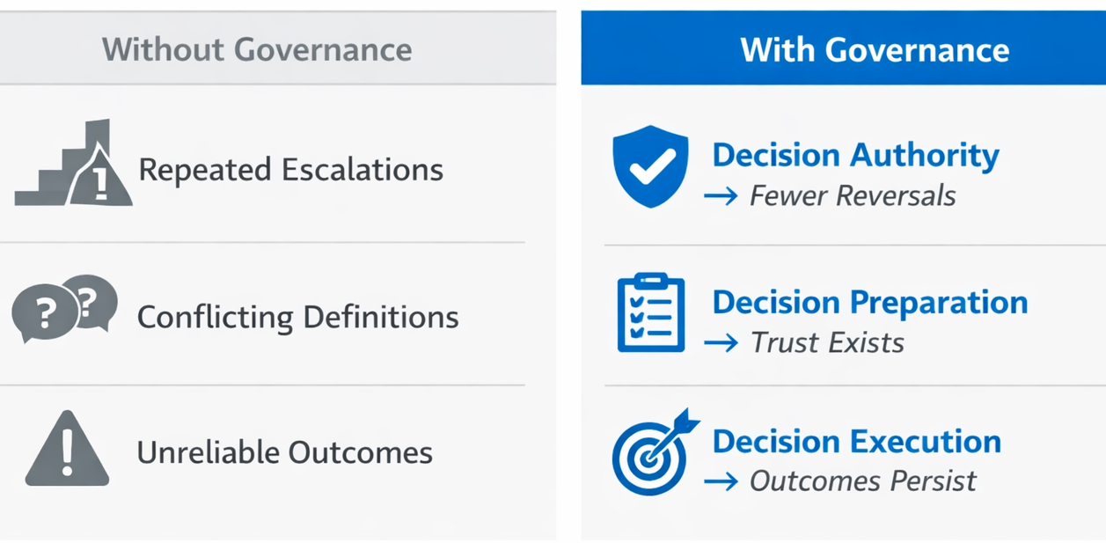
What Data Governance ROI Actually Looks Like
Governance ROI shows up when decisions hold
This is where speed is created

Slide 18
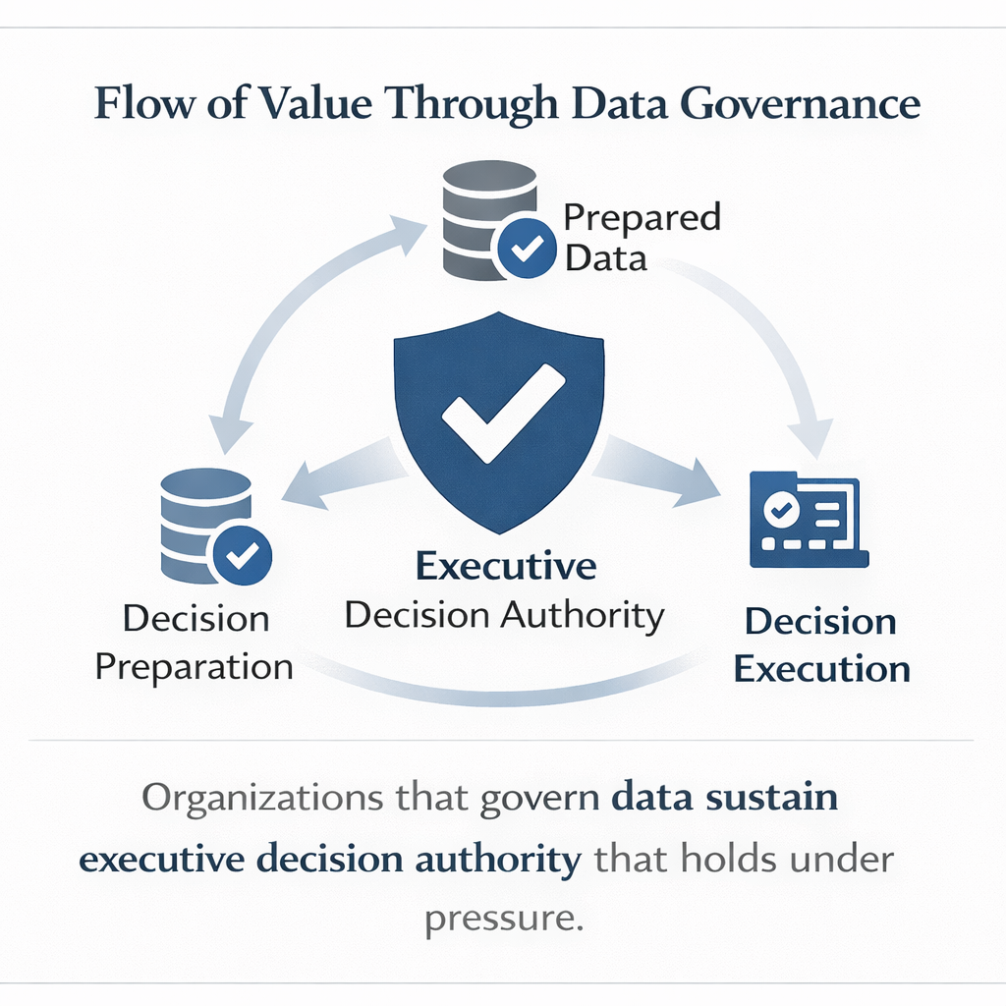
Flow of Value Through Data Governance
This is what ROI actually looks like in practice. Not savings, but decisions that move once and hold
If governance ROI is about decisions that hold, the Executive ROI Diagnostic is how executives can tell whether they have it

Slide 19
Executive ROI Diagnostic

Slide 20
The Executive ROI Diagnostic
Ask yourself:
How often are executive decisions revisited due to data issues?
How often do initiatives stall waiting for trust?
How often does leadership intervene late?
How often does AI pause because data cannot be defended?
Those delays are your ROI leakage

Slide 21
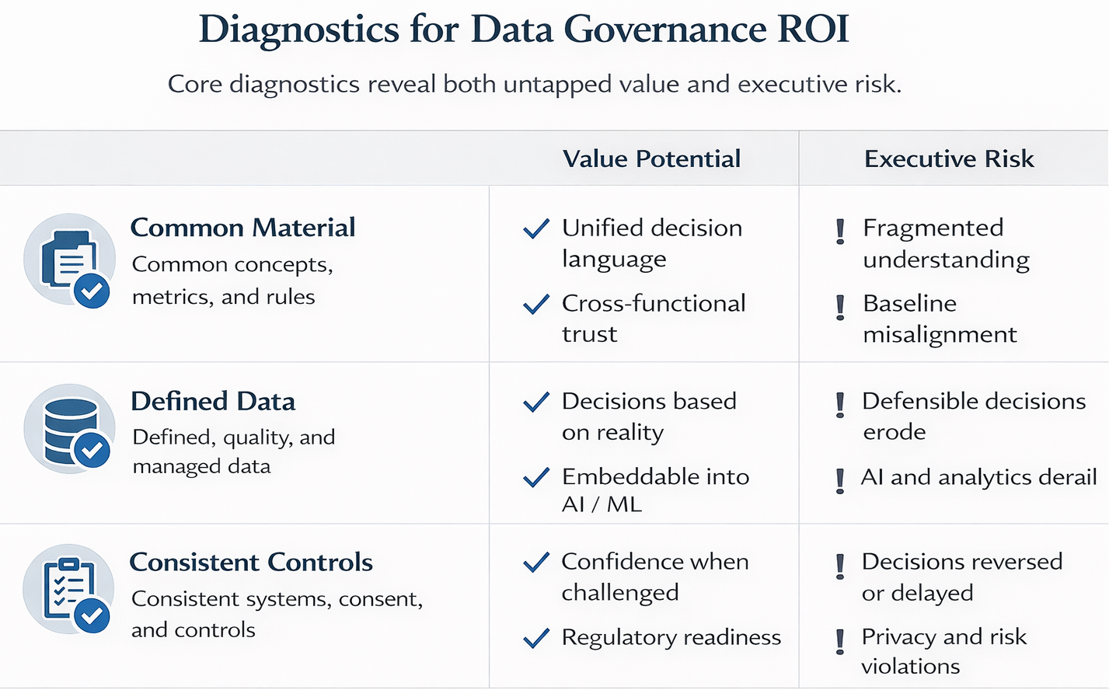
Measuring Whether Governance ROI Actually Exists

Slide 22
The Economic Truth
Data governance ROI is not measured in cost savings
It is measured in decisions that do not have to be made twice
Organizations that cannot articulate this ROI are already paying for its absence
In an AI-driven enterprise, that cost compounds quickly

