Slide 1
AI Governance Adoption: Why Most Efforts Stall and What Actually Works
An Executive Briefing
David Marco, PhD
DMarco@EWSolutions
President & Executive Advisor, EWSolutions

Slide 2
Context for Today’s Executive Briefing
David Marco, PhD
President & Executive Advisor, EWSolutions
Over 25 years advising senior leaders on data governance, analytics, and decision accountability at enterprise scale
Trusted by large healthcare, financial services, manufacturing, and federal organizations to design governance that holds under audit, regulation, and operational pressure
Work on metadata-driven governance and enterprise decision support cited in JAMIA and adopted as a foundational capability across dozens of large institutions
Former lead architect for mission-critical counterterrorism analytics and governance at the FBI
Selected organizations advised
(representative, not exhaustive)
Mayo Clinic • Blue Cross Blue Shield • BP • DoD • Discover • UnitedHealth • DHS
This briefing reflects patterns observed across multiple industries and regulatory environments, not a single organization’s experience

Slide 3
Why Most AI Governance Efforts Stall

Slide 4
The Adoption Paradox
Most executives agree AI governance matters
Most organizations still struggle to adopt it
Not because:
  leaders don’t care
  regulation is unclear
  technology is missing
But because governance is introduced in ways that slow decisions instead of strengthening them

Slide 5
The Industry Misdiagnosis
AI governance adoption is usually framed as a problem of:
  buy-in
  education
  change resistance
This misdiagnoses the problem
People do not resist governance
They resist unclear authority and unpredictable outcomes.

Slide 6
Where Adoption Actually Breaks. At Scale
AI governance efforts stall when:
  governance is layered on after pilots succeed
  accountability is ambiguous
  escalation paths are political
  decisions reverse under scrutiny
  executives intervene late
Adoption does not fail quietly
It fails at the moment of scale

Slide 7
Why Pilots Mask the Problem
Pilots succeed because:
  scope is controlled
  ownership is informal
  risk is deferred
Scale exposes what was never designed to hold:
  decision authority
  Accountability
  Trust
The technology didn’t fail
The governance model did

Slide 8
The Real Driver of Adoption
AI governance is adopted when it:
  reduces decision uncertainty
  shortens escalation cycles
  clarifies ownership
  increases executive confidence
Governance that strengthens decisions spreads
Governance that slows them is bypassed

Slide 9
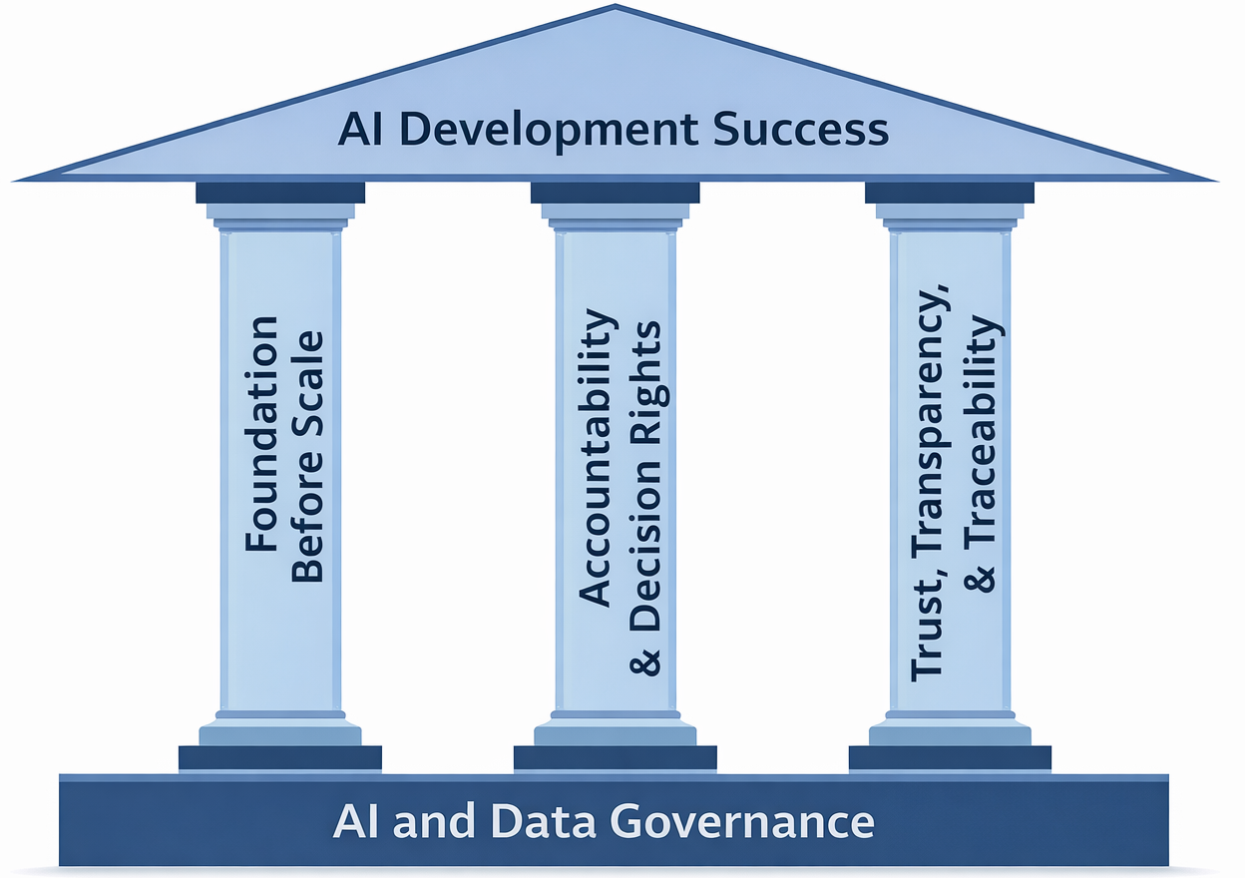
Three Conditions for Real Adoption
Adapted from David Marco’s Three Pillars of AI Development Success

Slide 10
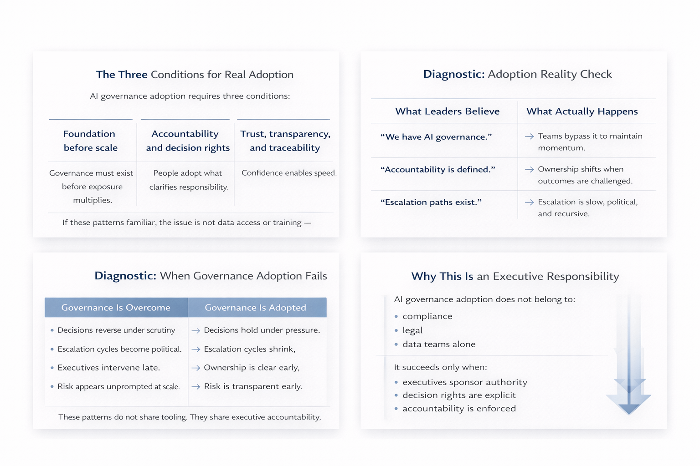
Three Conditions for Real Adoption
These conditions determine whether governance is adopted or bypassed

Slide 11
AI Governance Executive Diagnostic

Slide 12
Diagnostic Setup
Instead of asking:
“Do we have AI governance?”
Executives should ask:
“Is AI governance actually being used?”

Slide 13
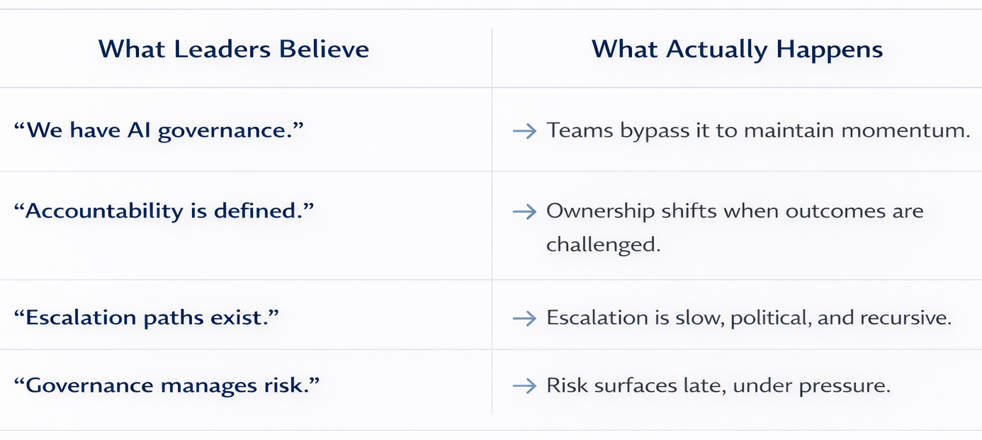
Diagnostic: Adoption Reality Check

Slide 14
Simple Executive Diagnostic

Slide 15
Diagnostic Conclusion
If governance:
  increases friction
  delays decisions
  triggers escalation
it has not been adopted, regardless of policy or tooling

Slide 16
What This Means for Executives
Adoption is not a compliance exercise
Adoption is not a tooling decision
Adoption is a leadership design choice

Slide 17
What Adoption Actually Looks Like
When AI governance is adopted:
  decisions hold when challenged
  escalation decreases with scale
  ownership is clear before issues arise
  trust exists before scrutiny
Governance becomes invisible because it works

Slide 18
Why This Is an Executive Responsibility
Adoption is a leadership outcome
AI governance adoption succeeds only when authority is explicitly sponsored at the executive level

Slide 19
Alignment with the Broader Arc
This is why:
  governance must hold under pressure
  risk management accelerates speed
  ROI shows up as decisions that don’t reverse
  data literacy becomes essential
Adoption is the connective tissue

Slide 20
Closing Thoughts
AI governance is adopted when it strengthens executive confidence under pressure

