Slide 1
The Decision Collapse When AI, Data, and Governance Drift Out of Alignment
An Executive Briefing
David Marco, PhD
DMarco@EWSolutions
President & Executive Advisor, EWSolutions

Slide 2
Context for Today’s Executive Briefing
David Marco, PhD
President & Executive Advisor, EWSolutions
Over 25 years advising senior leaders on data governance, analytics, and decision accountability at enterprise scale
Trusted by large healthcare, financial services, manufacturing, and federal organizations to design governance that holds under audit, regulation, and operational pressure
Work on metadata-driven governance and enterprise decision support cited in JAMIA and adopted as a foundational capability across dozens of large institutions
Former lead architect for mission-critical counterterrorism analytics and governance at the FBI
Selected organizations advised
(representative, not exhaustive)
Mayo Clinic • Blue Cross Blue Shield • BP • DoD • Discover • UnitedHealth • DHS
This briefing reflects patterns observed across multiple industries and regulatory environments, not a single organization’s experience

Slide 3
The Decision Collapse

Slide 4
The Illusion of Stability
Enterprise AI programs rarely fail suddenly
They operate
They deliver
They scale
And then, months or years later, decisions begin to unravel
Not because models degrade
But because alignment quietly erodes

Slide 5
What “Decision Collapse” Is (and Isn’t)
Decision collapse is not a technical failure
It is the moment when:
  decisions no longer hold under challenge
  accountability becomes ambiguous
  trust fragments across the organization
At that point:
  escalation replaces execution
  governance becomes negotiation
  speed collapses under scrutiny

Slide 6
Why Collapse Is Invisible at First
Decision collapse is rarely visible during:
  Pilots
  early production
  initial ROI
Why?
Because informal alignment masks structural weakness
Early success hides:
  unclear decision authority
  fragmented ownership
  implicit trust

Slide 7
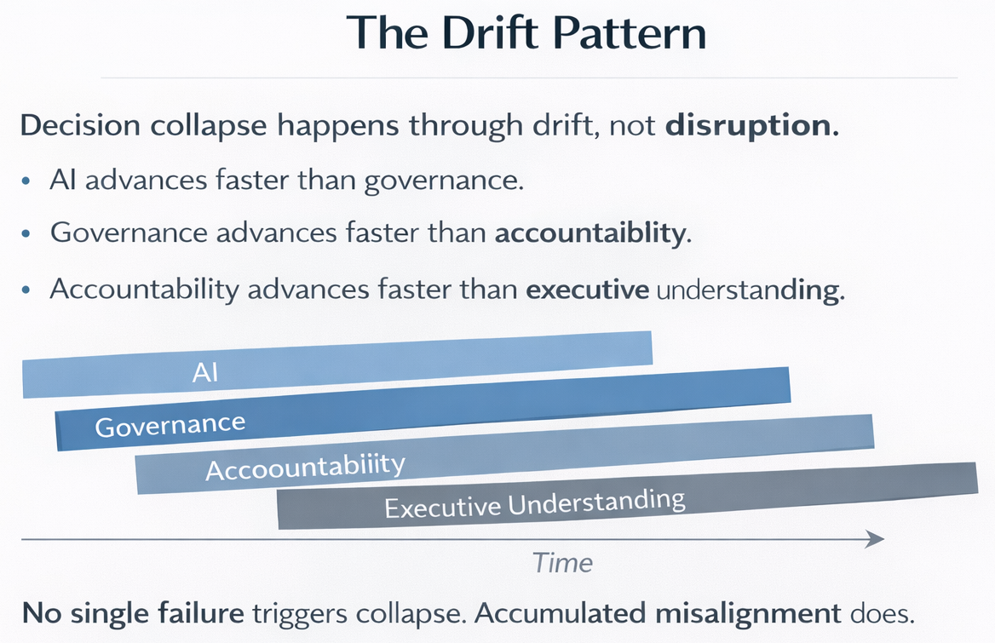
The Drift Pattern
Notes:
The Drift Pattern is about TIME

Slide 8
Why Executives Are Surprised
Executives are often surprised by collapse because:
  governance programs exist
  metrics look healthy
  training has occurred
  escalation paths are documented
These are signals of activity, not alignment
Alignment is only proven:
  under challenge
  under scrutiny
  under pressure

Slide 9
What Breaks First
In a decision collapse, the first thing to fail is not AI
It is:
  decision authority
  clarity of ownership
  confidence in outcomes
Technology continues working
Leadership coherence does not

Slide 10
Executive Diagnostic

Slide 11
Diagnostic Setup
Instead of asking:
“Is our AI working?”
Executives should ask:
“Do our decisions still hold?”
This is the earliest signal of collapse

Slide 12
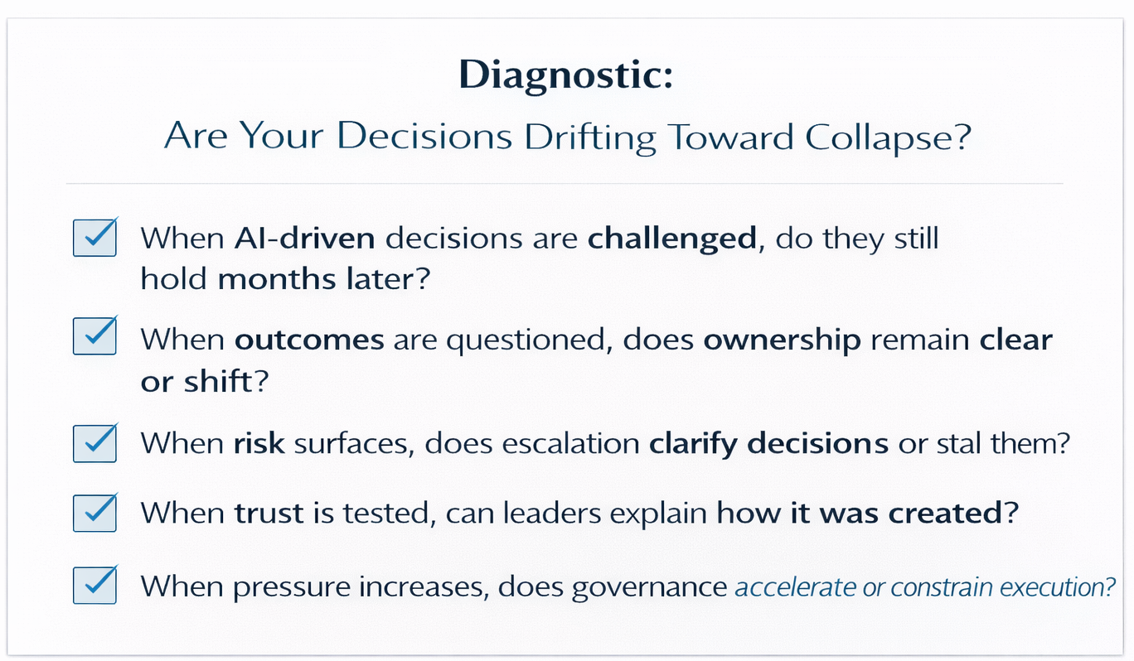
Core Executive Diagnostic

Slide 13
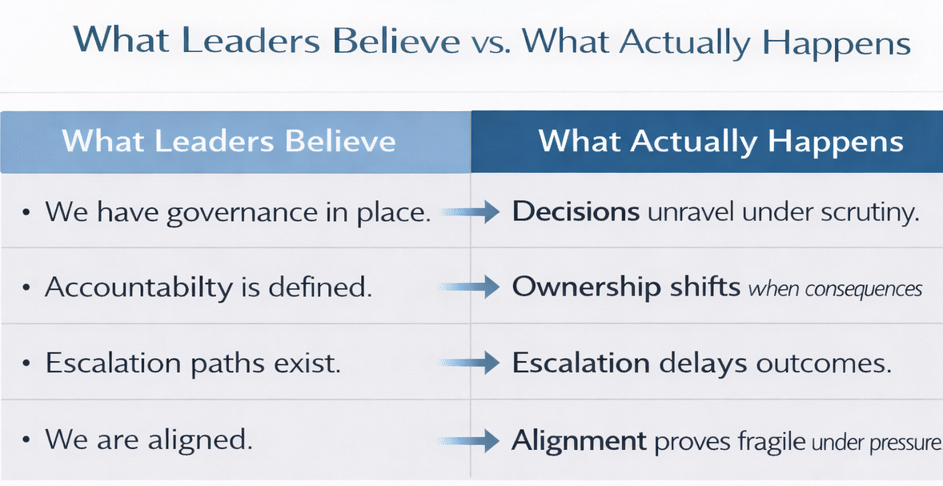
Companion Diagnostic

Slide 14
Diagnostic Interpretation
If answers are inconsistent, alignment is already drifting
Collapse does not require failure
Only time and pressure

Slide 15
The Executive Reality
Decision collapse is not a governance failure
It is an executive design failure
Alignment cannot be delegated
It must be intentionally maintained

Slide 16
Why This Matters Now
As AI scales:
  decision velocity increases
  exposure multiplies
  scrutiny intensifies
Drift accelerates
What once worked informally
becomes structurally fragile

Slide 17
Closing Thoughts
Enterprise AI fails quietly long before it fails visibly
By the time decisions collapse, control has already been lost

